Slide 1

WRITING SKILL

Slide 2
What is Writing
Writing can be said to be the act of forming the symbols: making marks on flat surface of some kind.
Writing is a process where symbols have to be arranged according to a certain conventions to form words and words have to be arranged to form sentences.
Writing involves encoding of a message of some kind: that is we translate our thoughts into language. (Byren, 1988)

Slide 3
Why Writing is important
Writing aims to capture a thought or idea, to transfer it to a permanent format, making it tangible.
The responsibility for that transfer falling on the writer’s shoulder.
If communication is the ultimate goal, write for your audience, not for personal style.
Writing has to be much clearer than spoken language because it lacks these assisting cues.
Great care is required to ensure that your message is accurately interpreted by its audience.

Slide 4
Cont….
Nearly any statement can be shortened while retaining its full content; concise wording is less likely to be misinterpreted.
Students’ performance is assessed through written work.
Documentation is mostly done in written form.

Slide 5
Types of Writing
E-mails
Letters and Memos
Free writing
Easy writing
Independent writing (poems)
Narrative writing (stories, histories)
Expository writing (reports, columns)
Persuasive writing (CVs, resume)

Slide 6
E-mails
E-mail is fast, convenient and easy
Email is now the dominant method of communicating in business.
Convenient for communicating with people in different places and different time zones.
Easier to communicate with people who understand written English but don’t speak it well.
Excellent mechanism for follow-up or action items after a meeting

Slide 7
Letters and Memos:
Letters and memos are the basic vehicles of business communication.
They should be brief and make a single point (no more than 2 pages)
Letters are for external communications.
Memos are for internal communications.

Slide 8
Free Writing:
Free writing is a prewriting technique in which a person writes continuously for a set period of time without regard to spelling, grammar, or topic. It produces raw, often unusable material, but helps writers overcome blocks of apathy and self-criticism.

Slide 9
Easy writing:
Sentences containing verbal’s.
Sentences using present and past participles (in phrases)
Appositive construction
Sentences using semicolons for more intricate formats
Sentences containing relative clauses
Sentences using subordinate clauses
Reproducible worksheets

Slide 10
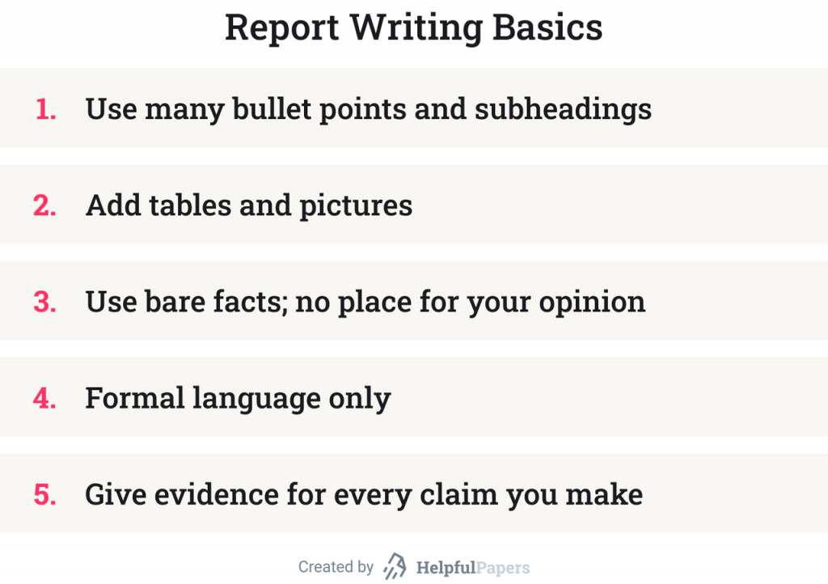
Expository Writing (REPORT)
A report is the description of an event that has already taken place.

Slide 11
Persuasive Writing
RESUME
A resume is a one- to two-page document presenting key facts about your professional experience, educational background, and skills.
CV CURRICULUM VITAE
A CV is a longer document that details the whole course of your career. A resume is used for job search, a CV—for academic purposes.

Slide 12

How to Improve students’ Writing

Slide 13
Write every day it’s better to practice for fifteen minutes every day than to practice for two hours three times a week
Proofread, edit, and revise
Know your strengths and accept your weaknesses.
Focus grammar
Share your work for feedback
Intensive and extensive reading
Respect every person’s personal best

Slide 14
Have high expectations, but set realistic outcomes which you can achieve
Celebrate successes in appropriate ways(Don’t become overconfident)
Establish time for daily writing
Look up for good writing pieces as reading improves your writing.

Slide 15
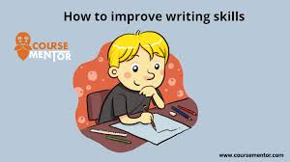
Principles of good writing.
Purpose
Use clear language
Be objective
Structure
Choice of words
Punctuation
Grammatically correct
Proofread
style

Slide 16
Purpose
First of all you must know why you are writing
The writing process is like a building
On the skeleton of purpose the building is constructed
There are many purposes of writing like good news , bad news , message of inquiry etc.

Slide 17
Use clear language
Use the sort of words you would use in conversation.
Use a level of language that is accessible to your readers.
Avoid overuse of clichés, similes and worn out phrases.
Write short sentences so that your reader get the basic or theme point of your phrase.

Slide 18
Be objective
Present the information objectively.
Your conclusions should arise logically from the information presented, and be based on the facts and evidence you have collected, rather than your own opinion or what you would like to happen.

Slide 19
Structure
A clear beginning, middle and an end.
It is more challenging to understand the chain of thought in written communication than when it is expressed verbally.
The blue print of your thoughts in your mind will decide the structure of your writing.

Slide 20
Choice of words
The words that you use determine your style.
Your writing could be easy and based on simple words so that your reader gets the main point.
Words can convey positive, negative, strong or weak messages depending on what you choose to express yourself.

Slide 21
Punctuation
Its have a large effect.
In speaking we don’t need to have any commas , full stop ,question mark etc.
But if u don’t use the commas , full stop etc. In your writing phrase the reader can get difficulty to read and understand.’
A writer should have a best knowledge to use these things.

Slide 22
Grammatically correct
No grammatical mistakes.
In writing grammar have a larger effect…if u write correct grammar the reader understand context easily.

Slide 23
Proofread
Proofread as many times as it is required to get it perfect.
This thing helps send out errors all the time.
After you finish writing, read and re-read and check for typos and grammar errors.
Check for concision and cut out every single word.

Slide 24
Style
Style is the main part, every writer owns his own style.
An easy style has a quick impact.
The message should be understood on first reading.

